Slide 1

Process Mining Virtual Internship
by
P.Keswitha
Roll No. 214G1A3238
Department of Computer Science and Engineering (Data Science)
Srinivasa Ramanujan Institute of Technology
(Affiliated to JNTUA & Approved by AICTE) (Accredited by NAAC with ‘A’ Grade & Accredited by NBA (EEE, ECE & CSE)
Rotarypuram Village, B K Samudram Mandal, Ananthapuramu – 515701.
2023 - 2024

Slide 2
Contents
Course Objective
Introduction
Technology
Applications
Modules
Real Time applications
Learning outcomes
GitHub Link
Queries

Slide 3
Course Objectives
The course objective in process mining is to provide a comprehensive understanding of the principles, techniques, and tools used in analyzing and improving business processes.
Students will learn how to apply process mining techniques to real-world datasets, interpret process models, identify process bottlenecks, and make data-driven process improvement decisions.
The course aims to equip the knowledge and skills necessary to effectively analyze and optimize business processes using process mining methodologies.

Slide 4
Introduction
Process Mining:
Process mining is a specialized area within data science and business process management that focuses on discovering, monitoring, and improving real-world business processes by analyzing event logs and data generated during these processes.
Process mining is a data-driven approach used to gain a deeper understanding of business processes.

Slide 5
Technology
Event Logging Systems: These are like digital record-keepers. They track every step people or systems take when working on tasks, like timestamps for when actions occur.
Special Software: Imagine detective software. It takes the event logs and examines them, revealing how tasks are really done. Examples include tools like "Celonis" and "Disco."
Data Visualization Tools: These are like storytellers. They take the detective's findings and turn them into easy-to-understand pictures and charts, like graphs and flowcharts.
Connectors and APIs: These are like bridges. They help to bring data from different systems together so the detective software can analyze it all.

Slide 6
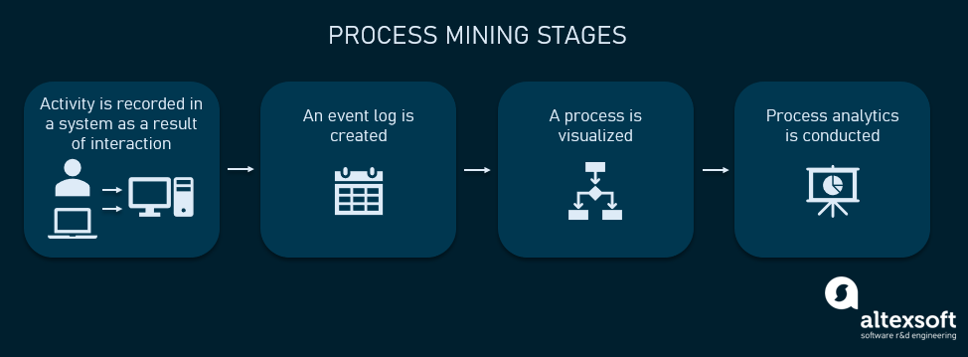
Stages in Process Mining
Fig.1: Process Mining Stages

Slide 7
Applications
Process mining has a wide range of applications across various industries and sectors. Here are some common applications of process mining:
Performance Monitoring: Organizations use process mining to continuously monitor process performance metrics.
Root Cause Analysis: When problems or errors occur in processes, process mining can help pinpoint the root causes.
Business Process Optimization: Process mining helps organizations identify bottlenecks, inefficiencies, and deviations in their business processes.
Fraud Detection: Process mining can detect fraudulent activities by analyzing patterns and anomalies in data. It helps identify unusual behavior and potentially fraudulent transactions.

Slide 8
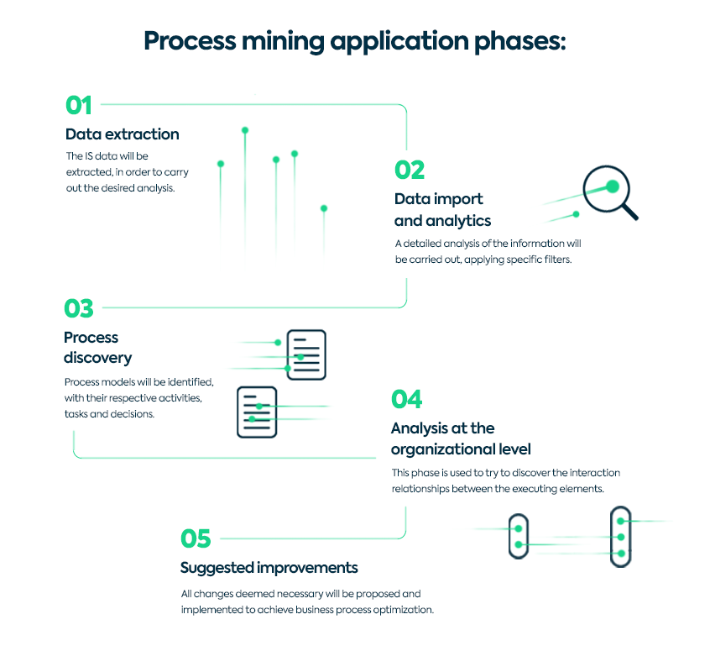
Applications
Fig.2: Process Mining Use Cases & Applications

Slide 9
Modules
1.Data Extraction and Integration Module:
This module is responsible for collecting and integrating event log data from various sources, such as databases, spreadsheets, and system logs.
2.Process Discovery Module:
The process discovery module is at the core of process mining. It uses event data to automatically generate process models that represent how activities are performed within a process.
Common techniques include creating flowcharts, Petri nets, or process trees.

Slide 10
Contd……..
3.Data Preprocessing Module:
Data preprocessing modules clean, filter, and transform raw event data to make it suitable for analysis.
This can involve handling missing values, correcting errors, and aligning data from different sources.
4. Conformance Checking Module:
This module compares the discovered process models to the actual process execution to identify deviations.
It helps organizations understand where processes may not be following the expected or documented path.

Slide 11
Real time Application
Healthcare Patient Monitoring:
Real-time process mining can be used to monitor patient care processes in hospitals and healthcare facilities.
It ensures that patients receive timely care, and any delays or deviations from protocols are promptly addressed.
Traffic Management:
In smart city applications, real-time process mining can monitor traffic flow, optimize traffic signals, and provide real-time traffic updates to commuters.

Slide 12
Contd…..
Customer Journey Analysis:
Real-time process mining is used to track and analyze customer interactions across various touchpoints, such as websites, mobile apps, and call centers.
It helps organizations provide personalized and timely customer experiences.

Slide 13
Learning Outcomes
In process mining, the main learning outcomes include:-
Identifying bottlenecks, inefficiencies, and deviations in the process.
Analyzing process performance metrics such as cycle time, throughput, and resource utilization.
Discovering process variations and identifying root causes of process issues.- Predicting future process behavior and making data-driven process improvement decisions.

Slide 14
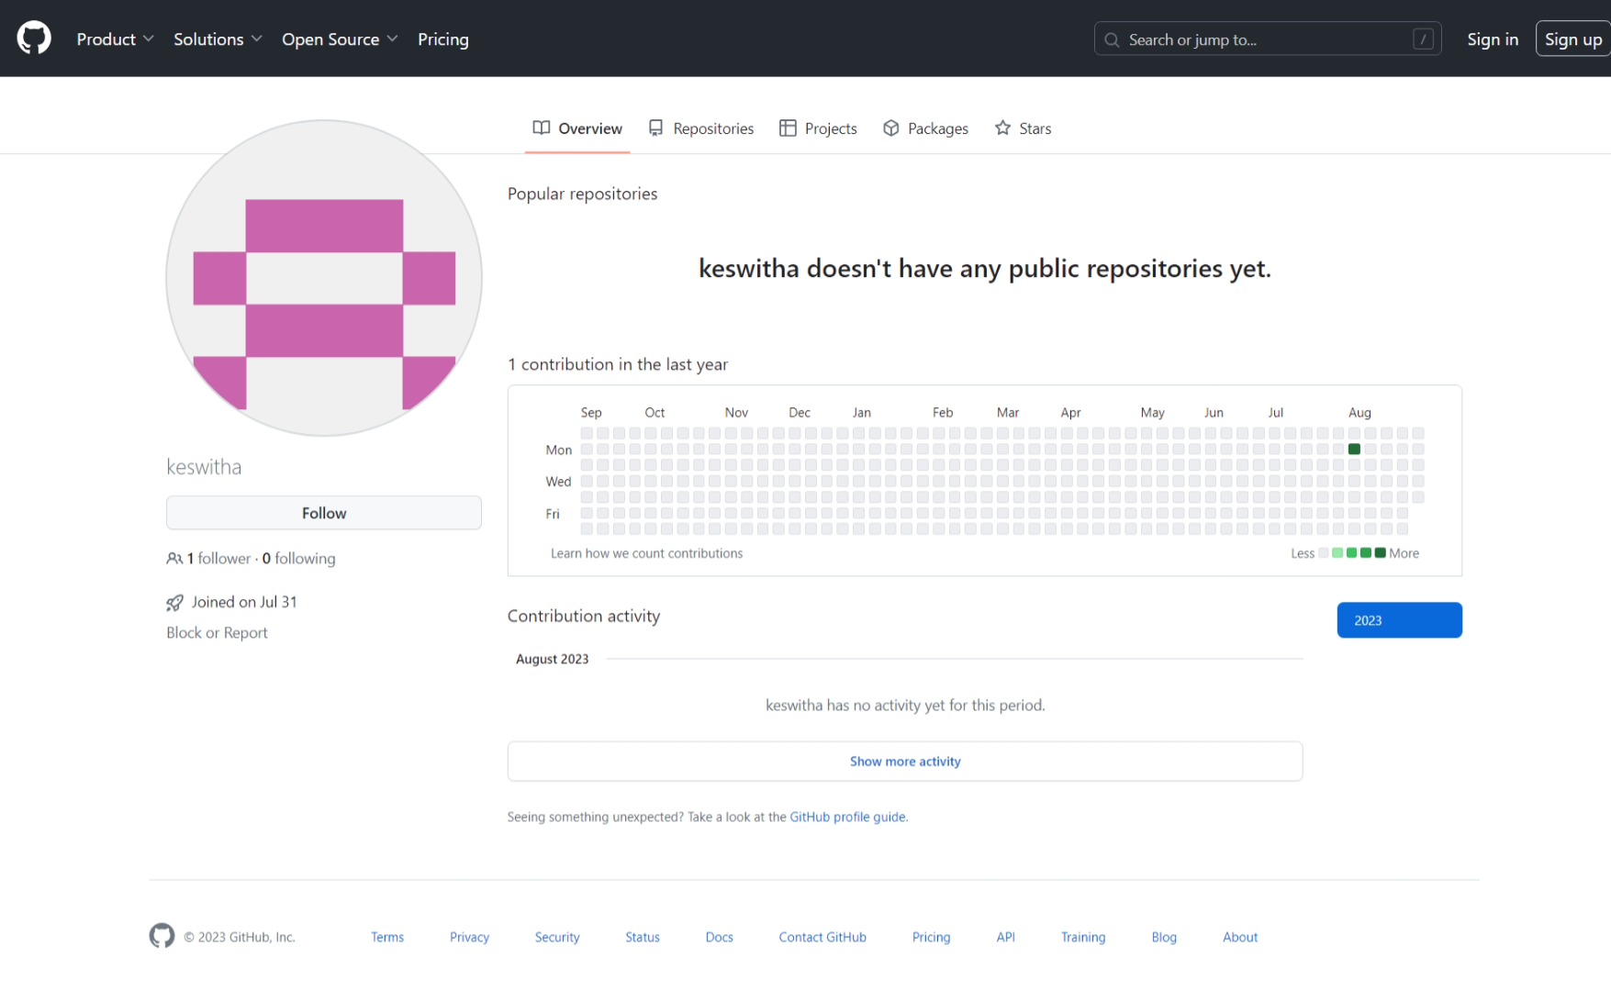
GitHub Account
GitHub Link : https://github.com/keswitha

Slide 15
Any Queries?

Slide 16
Thank You!!!

